Slide 1
Chapter 4
Digital Design and Computer Architecture, 2nd Edition
David Money Harris and Sarah L. Harris
硬件描述语言

Slide 2
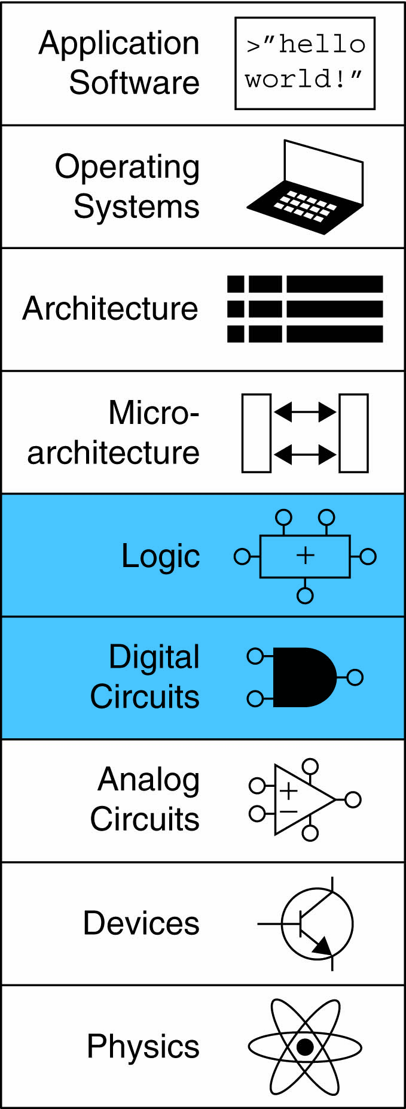
Chapter 4 :: Topics
Introduction引言
Combinational Logic组合逻辑
Structural Modeling结构建模
Sequential Logic时序逻辑
More Combinational Logic
更多组合逻辑
Finite State Machines有限状态机
Parameterized Modules参数化模块
Testbenches测试程序

Slide 3
Introduction引言
硬件描述语言
Hardware description language (HDL):
specifies logic function only只说明逻辑的功能
Computer-aided design (CAD) tool produces or synthesizes the optimized gates引入CAD工具去生成优化的门电路
Most commercial designs built using HDLs
Two leading HDLs:两种主要的硬件描述语言
SystemVerilog
developed in 1984 by Gateway Design Automation
IEEE standard (1364) in 1995
Extended in 2005 (IEEE STD 1800-2009)
VHDL 2008
Developed in 1981 by the Department of Defense
IEEE standard (1076) in 1987
Updated in 2008 (IEEE STD 1076-2008)

Slide 4
HDL to Gates从硬件描述语言到门
Simulation模拟
Inputs applied to circuit
Outputs checked for correctness
Millions of dollars saved by debugging in simulation instead of hardware
Synthesis综合
Transforms HDL code into a netlist describing the hardware (i.e., a list of gates and the wires connecting them)
IMPORTANT:
When using an HDL, think of the hardware the HDL should produce
在模拟阶段，在模块上加入输入，并检查输出以验证模块的操作是否正确。
逻辑综合将HDL代码转换成描述硬件（例如，逻辑门和连接它们的线）的网表
HDL的代码是代表硬件的

Slide 5
SystemVerilog Modules模块
模块：一个包括输入和输出的硬件块。与门、多路选择器和优先级电路都是硬件模块的例子。
Two types of Modules:
Behavioral: describe what a module does
Structural: describe how it is built from simpler modules
行为模型
结构模型
行为模型描述一个模块做什么；
结构模型应用层次化方法描述一个模块怎样由更简单的部件构造。

Slide 6
Behavioral SystemVerilog
行为模型
SystemVerilog:
中文书p109，例4.1
module example(input logic a, b, c,
output logic y);
assign y = ~a & ~b & ~c | a & ~b & ~c | a & ~b & c;
endmodule

Slide 7
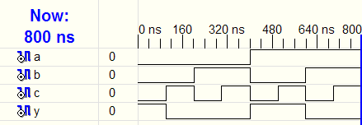
HDL Simulation硬件描述语言模拟
SystemVerilog:
module example(input logic a, b, c,
output logic y);
assign y = ~a & ~b & ~c | a & ~b & ~c | a & ~b & c;
endmodule
图4-1 模拟波形图

Slide 8
HDL Synthesis硬件描述语言综合
SystemVerilog:
module example(input logic a, b, c,
output logic y);
assign y = ~a & ~b & ~c | a & ~b & ~c | a & ~b & c;
endmodule
Synthesis:
图4-2 综合后的电路

Slide 9
SystemVerilog Syntax语法
Case sensitive区分大小写
Example: reset and Reset are not the same signal.
No names that start with numbers
Example: 2mux is an invalid name
Whitespace ignored忽略空格
Comments:
// single line comment
/* multiline
comment */

Slide 10
Structural Modeling - Hierarchy
结构模型建模 – 层次化
module and3(input logic a, b, c,
output logic y);
assign y = a & b & c;
endmodule
module inv(input logic a,
output logic y);
assign y = ~a;
endmodule
module nand3(input logic a, b, c
output logic y);
logic n1; // internal signal
and3 andgate(a, b, c, n1); // instance of and3
inv inverter(n1, y); // instance of inverter
endmodule

Slide 11
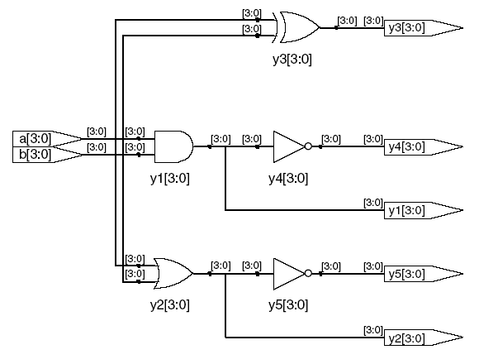
Bitwise Operators位操作符
中文书p113，例4.3
module gates(input logic [3:0] a, b,
output logic [3:0] y1, y2, y3, y4, y5);
/* Five different two-input logic
gates acting on 4 bit busses */
assign y1 = a & b; // AND
assign y2 = a | b; // OR
assign y3 = a ^ b; // XOR
assign y4 = ~(a & b); // NAND
assign y5 = ~(a | b); // NOR
endmodule
// single line comment
/*…*/ multiline comment
图4-4 gates模块综合后电路
按位操作符对单独位信号和多位总线进行操作

Slide 12
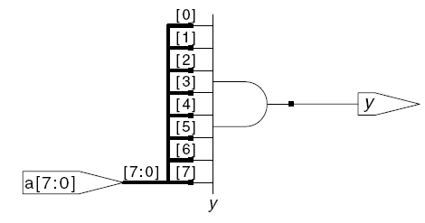
Reduction Operators缩减运算符
例4.4 八输入与门
module and8(input logic [7:0] a,
output logic y);
assign y = &a;
// &a is much easier to write than
// assign y = a[7] & a[6] & a[5] & a[4] &
// a[3] & a[2] & a[1] & a[0];
endmodule
图4-5 and8综合后电路

Slide 13
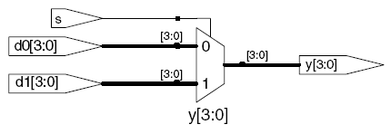
Conditional Assignment条件赋值
module mux2(input logic [3:0] d0, d1,
input logic s,
output logic [3:0] y);
assign y = s ? d1 : d0;
endmodule
? : is also called a ternary operator because it
operates on 3 inputs: s, d1, and d0.
图4-6 mux2综合后电路
三元运算符

Slide 14
Internal Variables内部变量
module fulladder(input logic a, b, cin,
output logic s, cout);
logic p, g; // internal nodes
assign p = a ^ b;
assign g = a & b;
assign s = p ^ cin;
assign cout = g | (p & cin);
endmodule
图4-8 fulladder综合后电路

Slide 15
Precedence优先级
见中文书p119，表4-1/表4-2
Order of operations
Highest
~ | NOT
*, /, % | mult, div, mod
+, - | add,sub
<<, >> | shift
<<<, >>> | arithmetic shift
<, <=, >, >= | comparison
==, != | equal, not equal
&, ~& | AND, NAND
^, ~^ | XOR, XNOR
|, ~| | OR, NOR
?: | ternary operator
Lowest

Slide 16
Numbers数字
Format: N‘Bvalue声明常量的格式
N = number of bits, B = base，N表示位数、B表示基数
N‘B is optional but recommended (default is decimal)基数默认为10
Number | # Bits | Base | Decimal Equivalent | Stored
3'b101 | 3 | binary | 5 | 101
'b11 | unsized | binary | 3 | 00…0011
8'b11 | 8 | binary | 3 | 00000011
8'b1010_1011 | 8 | binary | 171 | 10101011
3'd6 | 3 | decimal | 6 | 110
6'o42 | 6 | octal | 34 | 100010
8'hAB | 8 | hexadecimal | 171 | 10101011
42 | Unsized | decimal | 42 | 00…0101010
表4-3 Verilog的数字

Slide 17
Z: Floating Output 浮空输出
见中文书p121，例4.10
SystemVerilog:
module tristate(input logic [3:0] a,
input logic en,
output logic [3:0] y);
assign y = en ? a : 4'bz;
endmodule
图4-9 三态缓冲器

Slide 18
Delays延迟，见中文书p123
module example(input logic a, b, c,
output logic y);
logic ab, bb, cb, n1, n2, n3;
assign #1 {ab, bb, cb} = ~{a, b, c};
assign #2 n1 = ab & bb & cb;
assign #2 n2 = a & bb & cb;
assign #2 n3 = a & bb & c;
assign #4 y = n1 | n2 | n3;
endmodule
图4-10 带延迟的模拟波形示例（来自于ModelSim模拟器）

Slide 19
Delays延迟
module example(input logic a, b, c,
output logic y);
logic ab, bb, cb, n1, n2, n3;
assign #1 {ab, bb, cb} =
~{a, b, c};
assign #2 n1 = ab & bb & cb;
assign #2 n2 = a & bb & cb;
assign #2 n3 = a & bb & c;
assign #4 y = n1 | n2 | n3;
endmodule

Slide 20
Sequential Logic时序逻辑
SystemVerilog uses Idioms to describe latches, flip-flops and FSMs
Other coding styles may simulate correctly but produce incorrect hardware
- HDL综合器能辨别出特定的风格，然后把它们转换成特定的时序电路，如锁存器、触发器、有限状态机
- 其他风格的编码可能在模拟时正确，但是在综合电路时会出现明显或不明显的错误

Slide 21
Always Statement
always语句
General Structure:一般的结构
always @(sensitivity list)
statement;
Whenever the event in sensitivity list occurs, statement is executed
这个语句只在敏感信号列表中说明的事件发生时才执行

Slide 22
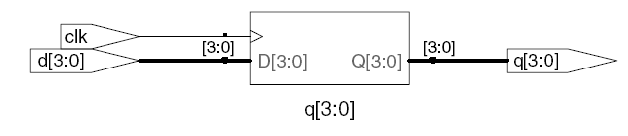
D Flip-Flop D触发器
module flop(input logic clk,
input logic [3:0] d,
output logic [3:0] q);
always @(posedge clk)
q <= d; // pronounced “q gets d”
endmodule
图4-16 触发器综合后电路

Slide 23
Resettable D Flip-Flop 可复位D触发器
module flopr(input logic clk,
input logic reset,
input logic [3:0] d,
output logic [3:0] q);
// synchronous reset
always @(posedge clk)
if (reset) q <= 4'b0;
else q <= d;
endmodule
复位可以是同步也可以是异步。异步复位马上就生效，而同步复位在下一个时钟上升沿时才复位输出。
图4-17 flopr综合后电路，同步复位

Slide 24
Resettable D Flip-Flop 可复位D触发器
module flopr(input logic clk,
input logic reset,
input logic [3:0] d,
output logic [3:0] q);
// asynchronous reset
always_ff @(posedge clk, posedge reset)
if (reset) q <= 4'b0;
else q <= d;
endmodule
Posedge reset在异步复位触发器的敏感信号列表中，但不在同步复位触发器中
图4-17 flopr综合后电路，异步复位

Slide 25
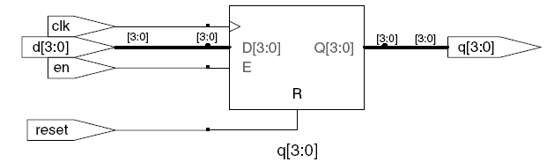
D Flip-Flop with Enable带使能端的D触发器
module flopren(input logic clk,
input logic reset,
input logic en,
input logic [3:0] d,
output logic [3:0] q);
// asynchronous reset and enable
always @(posedge clk, posedge reset)
if (reset) q <= 4'b0;
else if (en) q <= d;
endmodule
带使能端的触发器只在使能有效时才会响应时钟

Slide 26
Latch锁存器
见中文书p134
module latch(input logic clk,
input logic [3:0] d,
output logic [3:0] q);
always_latch
if (clk) q <= d;
endmodule
图4-21 锁存器综合后电路
不是所有的综合工具都能很好地支持D锁存器，除非你知道你的工具支持锁存器，或者你有强烈的理由需要使用它，不然的话，最好使用边沿触发器代替。还要注意HDL代码不能隐含任何非预期的锁存器，如果不小心的话，这种器件很容易出现。

Slide 27
Combinational Logic using always
// combinational logic using an always statement
module gates(input logic [3:0] a, b,
output logic [3:0] y1, y2, y3, y4, y5);
always_comb // need begin/end because there is
begin // more than one statement in always
y1 = a & b; // AND
y2 = a | b; // OR
y3 = a ^ b; // XOR
y4 = ~(a & b); // NAND
y5 = ~(a | b); // NOR
end
endmodule
This hardware could be described with assign statements using fewer lines of code, so it’s better to use assign statements in this case.
always语句用于组合逻辑的行为级描述，其中敏感信号列表中包含了所有的输入以对其改变做出响应，同时正文对每一种可能的输入组合都定义了对应的输出。

Slide 28
Combinational Logic using case
module sevenseg(input logic [3:0] data,
output logic [6:0] segments);
always_comb
case (data)
// abc_defg
0: segments = 7'b111_1110;
1: segments = 7'b011_0000;
2: segments = 7'b110_1101;
3: segments = 7'b111_1001;
4: segments = 7'b011_0011;
5: segments = 7'b101_1011;
6: segments = 7'b101_1111;
7: segments = 7'b111_0000;
8: segments = 7'b111_1111;
9: segments = 7'b111_0011;
default: segments = 7'b000_0000; // required
endcase
endmodule
中文书p138，例4.25
使用case语句描述七段数码管显示译码器，case语句基于输入值做出不同的行为。一个case语句中，当所有可能的输入组合都被定义时，就表示为组合逻辑。否则，它就表示时序逻辑，因为在未定义情况下输出会保持旧值。

Slide 29
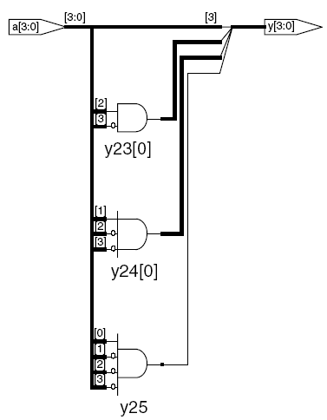
Combinational Logic using casez
例4.28 使用casez的优先级电路
module priority_casez(input logic [3:0] a,
output logic [3:0] y);
always_comb
casez(a)
4'b1???: y = 4'b1000; // ? = don’t care
4'b01??: y = 4'b0100;
4'b001?: y = 4'b0010;
4'b0001: y = 4'b0001;
default: y = 4'b0000;
endcase
endmodule

Slide 30
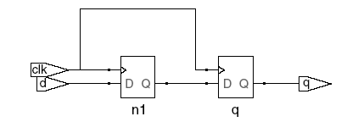

Blocking vs. Nonblocking Assignment
阻塞式与非阻塞式赋值
<= is nonblocking assignment
Occurs simultaneously with others
= is blocking assignment
Occurs in order it appears in file
非阻塞赋值=并行赋值
阻塞赋值=连续赋值
// Good synchronizer using
// nonblocking assignments
module syncgood(input logic clk,
input logic d,
output logic q);
logic n1;
always_ff @(posedge clk)
begin
n1 <= d; // nonblocking
q <= n1; // nonblocking
end
endmodule
// Bad synchronizer using
// blocking assignments
module syncbad(input logic clk,
input logic d,
output logic q);
logic n1;
always_ff @(posedge clk)
begin
n1 = d; // blocking
q = n1; // blocking
end
endmodule

Slide 31
Finite State Machines (FSMs)
有限状态机
Three blocks:
next state logic
state register
output logic
下一状态逻辑
状态寄存器
输出逻辑

Slide 32
FSM Example: Divide by 3
3分频计数器的有限状态机
The double circle indicates the reset state
与图3-28 状态转移图对应，中文书p80
表示复位状态

Slide 33
FSM in SystemVerilog
见p146，例4.31
module divideby3FSM (input logic clk,
input logic reset,
output logic q);
typedef enum logic [1:0] {S0, S1, S2} statetype;
statetype [1:0] state, nextstate;
// state register
always_ff @ (posedge clk, posedge reset)
if (reset) state <= S0;
else state <= nextstate;
// next state logic
always_comb
case (state)
S0: nextstate = S1;
S1: nextstate = S2;
S2: nextstate = S0;
default: nextstate = S0;
endcase
// output logic
assign q = (state == S0);
endmodule
Parameter语句用于定义模块内的常量。通过parameter对状态命名并不是必须的，但是这样做会使修改状态编码更容易，而且代码可读性更强。
Case语句用于定义状态转换表的方法。因为下一状态逻辑必须是组合逻辑，所以dafault不能缺少。
当状态为s0时，输出y为1。如果a等于b，相等比较式a==b得到值1，否则为0。不相等比较式a!=b则相反，在a不等于b时得到值1。

Slide 34
Parameterized Modules参数化模块
见p152，例4.34
Verilog允许在定义输入输出信号之前使用#(parameter…)语句定义参数。Parameter语句包括参数width的默认值（8）。输入和输出信号的位数依赖于这个参数。
2:1 mux:
module mux2
#(parameter width = 8) // name and default value
(input logic [width-1:0] d0, d1,
input logic s,
output logic [width-1:0] y);
assign y = s ? d1 : d0;
endmodule
Instance with 8-bit bus width (uses default):
mux2 mux1(d0, d1, s, out);
Instance with 12-bit bus width:
mux2 #(12) lowmux(d0, d1, s, out);

Slide 35
Testbenches测试程序
HDL that tests another module: device under test (dut)
Not synthesizeable
Types:
Simple
Self-checking
Self-checking with test vectors
测试程序是用于测试其他待测试模块（DUT）的硬件描述语言模块
测试程序包含了向待测试模块提供输入的语句，以测试是否产生了理想的正确输出。输入和期待的输出模式称为测试向量（test vectors）
自测试的测试程序

Slide 36
Testbench Example测试程序例子
Write SystemVerilog code to implement the following function in hardware:
y = bc + ab
Name the module sillyfunction

Slide 37
Testbench Example测试程序例子
Write SystemVerilog code to implement the following function in hardware:
y = bc + ab
module sillyfunction(input logic a, b, c,
output logic y);
assign y = ~b & ~c | a & ~b;
endmodule

Slide 38
Simple Testbench简单的测试程序例子
见p156，例4.37
module testbench1();
logic a, b, c;
logic y;
// instantiate device under test
sillyfunction dut(a, b, c, y);
// apply inputs one at a time
initial begin
a = 0; b = 0; c = 0; #10;
c = 1; #10;
b = 1; c = 0; #10;
c = 1; #10;
a = 1; b = 0; c = 0; #10;
c = 1; #10;
b = 1; c = 0; #10;
c = 1; #10;
end
endmodule
Initial语句在模拟开始时执行体内的语句。首先提供输入000，然后等待10个单位时间。随后提供001，之后等待10个单位时间，并按照此方式执行，以提供了所有8个可能的输入。

Slide 39
Self-checking Testbench
见p157，例4.38
能自测试的测试程序
module testbench2();
logic a, b, c;
logic y;
sillyfunction dut(a, b, c, y); // instantiate dut
initial begin // apply inputs, check results one at a time
a = 0; b = 0; c = 0; #10;
if (y !== 1) $display("000 failed.");
c = 1; #10;
if (y !== 0) $display("001 failed.");
b = 1; c = 0; #10;
if (y !== 0) $display("010 failed.");
c = 1; #10;
if (y !== 0) $display("011 failed.");
a = 1; b = 0; c = 0; #10;
if (y !== 1) $display("100 failed.");
c = 1; #10;
if (y !== 1) $display("101 failed.");
b = 1; c = 0; #10;
if (y !== 0) $display("110 failed.");
c = 1; #10;
if (y !== 0) $display("111 failed.");
end
endmodule
当提供每个输入测试向量后，测试模块将y和期望值进行检查。在Verilog中，可以在不包括x和z值的信号中间使用==或者!=的对比式。测试程序分别使用===和！==运算符判断相等或不等，因为这些操作符能对包含x和z的操作数正确操作。

Slide 40
Testbench with Testvectors
带测试向量的测试程序
见P158，例4.39
Testvector file: inputs and expected outputs
Testbench:
Generate clock for assigning inputs, reading outputs
Read testvectors file into array
Assign inputs, expected outputs
Compare outputs with expected outputs and report errors
测试向量：输入和期待的输出模式
测试程序

Slide 41
Testbench with Testvectors
带测试向量的测试程序
Testbench clock:
assign inputs (on rising edge)
compare outputs with expected outputs (on falling edge).
Testbench clock also used as clock for synchronous sequential circuits

Slide 42
Testvectors File测试向量文件
是包含了二进制格式输入和期待输出的文本文件
File: example.tv
contains vectors of abc_yexpected
000_1
001_0
010_0
011_0
100_1
101_1
110_0
111_0
在需要很大量测试向量的模块中，为每个测试向量编写代码依然是冗繁的工作。一个比较好的方法是把测试向量置于独立的文件中。测试程序简单地从文件中读取测试向量，向DUT输入测试向量，检查DUT输出值是否与输出向量一致，之后重复这个过程知道测试向量文件的结尾。
测试程序使用没有敏感信号列表的always/proess语句产生了一个时钟，因此它会连续不断地重复运行。模拟开始时，从测试文件读取测试向量，之后提供两个周期的reset脉冲。

Slide 43
1. Generate Clock产生时钟
module testbench3();
logic clk, reset;
logic a, b, c, yexpected;
logic y;
logic [31:0] vectornum, errors; // bookkeeping variables
logic [3:0] testvectors[10000:0]; // array of testvectors
// instantiate device under test
sillyfunction dut(a, b, c, y);
// generate clock
always // no sensitivity list, so it always executes
begin
clk = 1; #5; clk = 0; #5;
end

Slide 44
2. Read Testvectors into Array
读取测试向量到队列
// at start of test, load vectors and pulse reset
initial
begin
$readmemb("example.tv", testvectors);
vectornum = 0; errors = 0;
reset = 1; #27; reset = 0;
end
// Note: $readmemh reads testvector files written in
// hexadecimal

Slide 45
3. Assign Inputs & Expected Outputs
赋值输入和期望的输出
// apply test vectors on rising edge of clk
always @(posedge clk)
begin
#1; {a, b, c, yexpected} = testvectors[vectornum];
end

Slide 46
4. Compare with Expected Outputs
比较期望的输出
// check results on falling edge of clk
always @(negedge clk)
if (~reset) begin // skip during reset
if (y !== yexpected) begin
$display("Error: inputs = %b", {a, b, c});
$display(" outputs = %b (%b expected)",y,yexpected);
errors = errors + 1;
end
// Note: to print in hexadecimal, use %h. For example,
// $display(“Error: inputs = %h”, {a, b, c});

Slide 47
4. Compare with Expected Outputs
比较期望的输出
// increment array index and read next testvector
vectornum = vectornum + 1;
if (testvectors[vectornum] === 4'bx) begin
$display("%d tests completed with %d errors",
vectornum, errors);
$finish;
end
end
endmodule
// === and !== can compare values that are 1, 0, x, or z.

